Slide 1
Business requirement
Development unsupervised Machine Learning Moosic Model
Client: Moosic GmBH Wien, Austria
Prepared by Damir Selak

Slide 2
Business requirement >> Development unsupervised Machine Learning Moosic Model<<
Content
Business requirement, product results and activities description
Algorithm methodology
Playlists presentation
Example of 1 song from a few different clusters.
PROs and CONs of using clustering to create playlists
K-Means method advantages and disadvantages to create playlists
Recommendation for moving forward with K-Means algorithm
Recommendation for moving forward with other methods to create playlists (not considered)
PRESENT DATA SET FROM KMEANS
Are Spotify’s audio features able to identify “similar songs”, as defined by humanly detectable criteria?
Additional data for better user experience (production years)
Recommendation and next steps
Learnings from the project

Slide 3
Business requirement, product results and activities description
Business requirement:
Development unsupervised Machine Learning Moosic Model (MLM) by “Automatisation of Moosic playlists”
Results:
R1. Algorithm for unsupervised Machine learning Model (MLM) developed
R2. Algorithm successful tested and functionality confirmed

Slide 4
Business requirement, product results and activities description
Main activities:
A1. Importing and reviewing data frame quality
A2. Cleaning and scaling data frame
A3. Plotting dataframe in Histogram to visually check correlation between several pairs of chosen data values to be used for K-Clustering
A4. Plotting data frame in scatter plot to visually check correlation between several pairs of chosen data values to be used for K-Clustering
A5. Choosing the right number of cluster, using inertia
A6. Bringing decision on optimum number of clusters and set of data pairs which will be used for algorithm development
A7. Data scaling Quantile transformer
A8. K-means calculation for chosen pairs of data for clustering x="energy", y="acousticness"
A9. Plotting and exploring our KMeans results / Comparing our centroids and our dataset
A10. Adding new cluster column to our data frame and defining the names of 10 clusters based on music genre
A11. Data frame analysis to check cluster structure
A12. Visualizing the clusters in a scatterplot with K-means features x="energy", y="acousticness"
A13. Explore relation between sum of energy and accusticness
A14. Ploting relation between energy and accusticness

Slide 5
Algorithm methodology
First we explored meaning of the different data set values in order to understand music meaning of the i.e. accusticness, energy, valence, loudness, etc
After that we plotted in scatter and histogram plot several pairs of chosen data values to visually check correlation between them
Choosing x="energy", y="acousticness" as basic values for clusterisation as those two data values showed significant correlation increase of the energy and decrease of the accusticness in histogram and descending function of same values in scatter plot. DATA SET IS NICELY STRETCHED next slide
Using Inertia to find the right number of clusters “10” and The K-means algorithm for clustering, next slide…
Data set cleaning and scaling using robust preprocessing scheme Quantile transformer
Advantages:
transforms the features to follow a uniform or a normal distribution
tends to spread out the most frequent values
reduces the impact of (marginal) outliers
Recommended for ML models
Disadvantages:
this transform is non-linear.
It may distort linear correlations

Slide 6
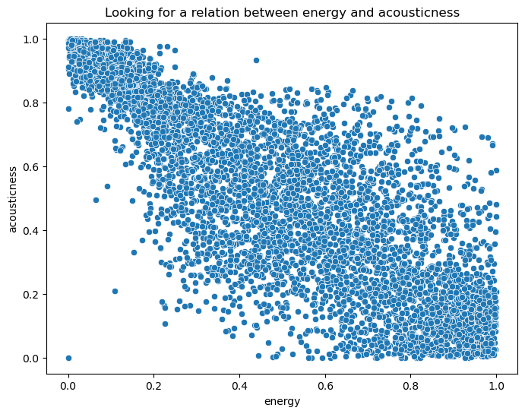
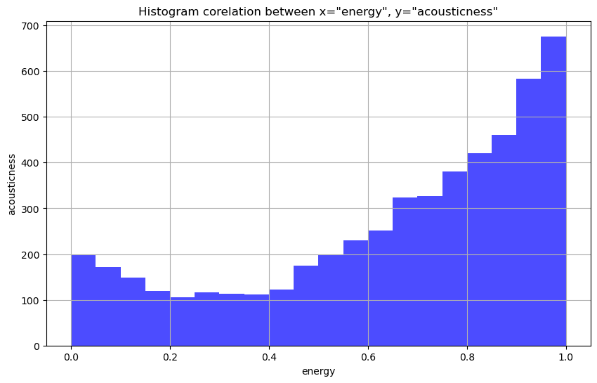
Algorithm methodology Chosing x="energy", y="acousticness"

Slide 7
Algorithm methodology k-means pro and cons
Advantages of k-means algorithm
Relatively simple to implement.
Scales to large data sets.
Guarantees convergence (ALL DATA ON ONE PLACE)
Can warm-start the positions of centroids.
Easily adapts to new examples.
Generalizes to clusters of different shapes and sizes, such as elliptical clusters.
Disadvantages of k-means
Being dependent on initial values.
Clustering data of varying sizes and density.
Clustering outliers Centroids can be dragged by outliers, or outliers might get their own cluster instead of being ignored . Minimized using Quantile transformer
Scaling with number of dimensions

Slide 8
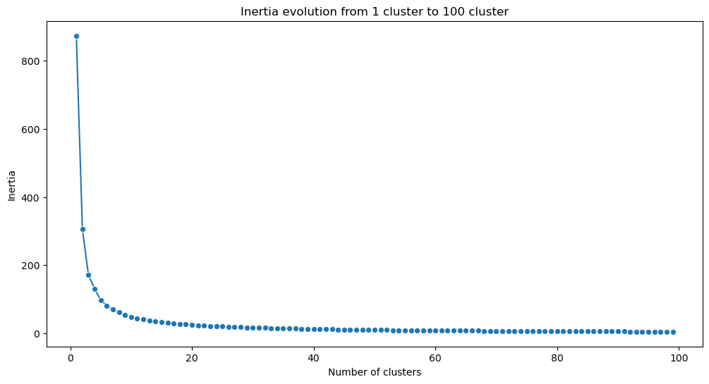
Algorithm methodology INERTIA

Slide 9
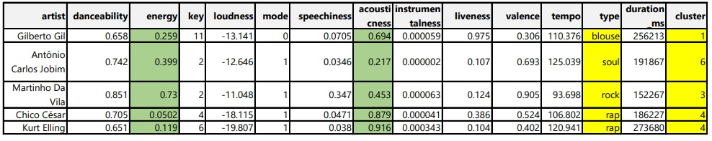
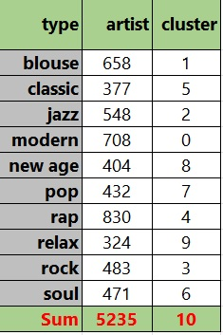
Playlists presentation
Example of 1 song from a few different clusters.
Observe “energy” and “acusticness” as it
correlate negatively

Slide 10
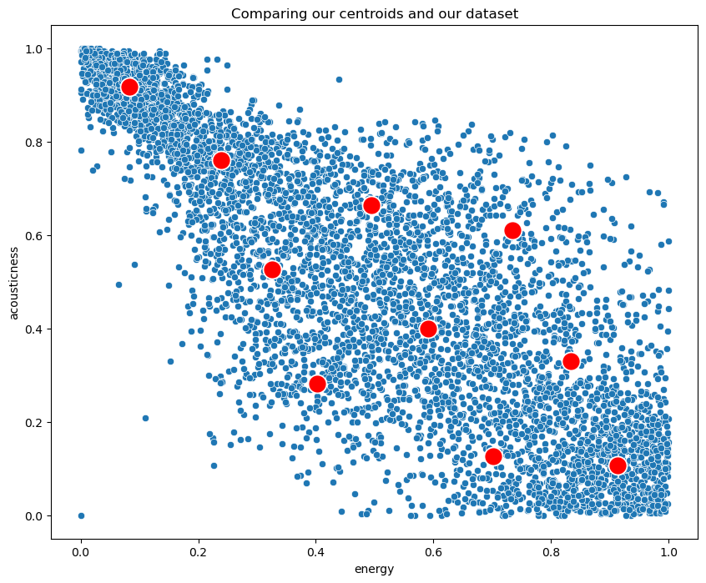
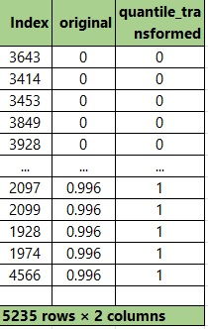
PRESENT DATA SET FROM KMEANS
Transformation or aspect ratio using quantile transformer

Slide 11
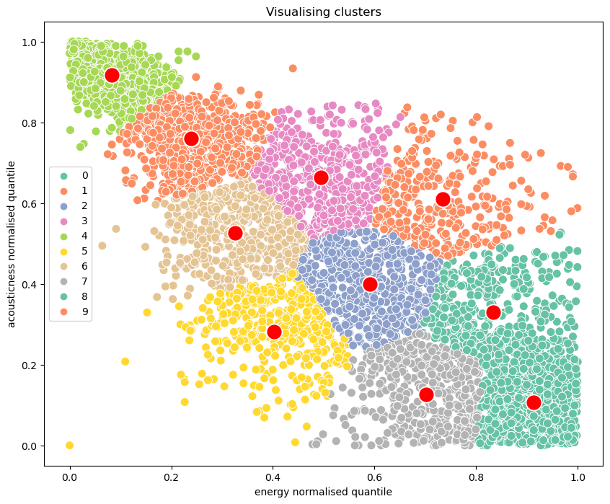
PRESENT DATA SET FROM KMEANS

Slide 12
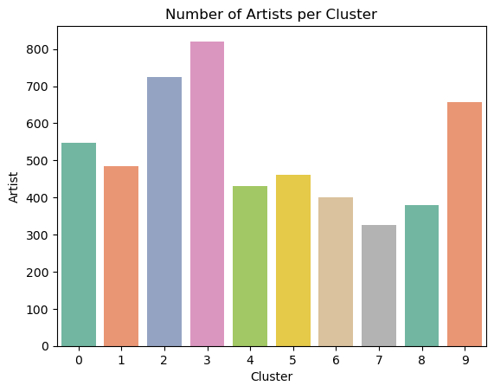
Data frame and clusters analysis
Explore and Plot number of artists per clusters based on genre classification to check structure of the clusters and potentially propose importing new melodies to client
Additional melodies and artist should be included in the playing list clusters with lower number of artist and melodies i.e.
# soul = 6
# pop = 7

Slide 13
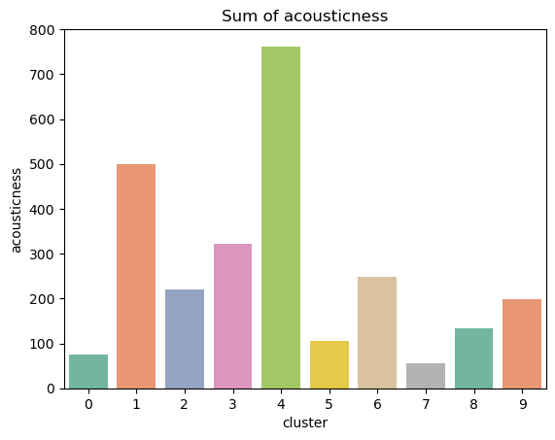
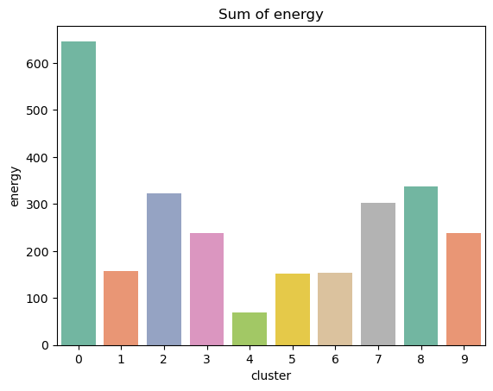
Data frame and clusters analysis
EXPLORE and plot RELATION BETWEEN SUM OF ENERGY AND ACUSTICNESS
It generaly accepted opinion that today pop and generally modern music is less acoustic and more energetic than in the 1950s Pop music is louder, less acoustic and more energetic than in the 1950s | Digital music and audio | The Guardian
Our clustering decision is confirmed by this wide accepted opinion, but in order to prove it our data frame should be amended with additional column "Song_year_created"

Slide 14
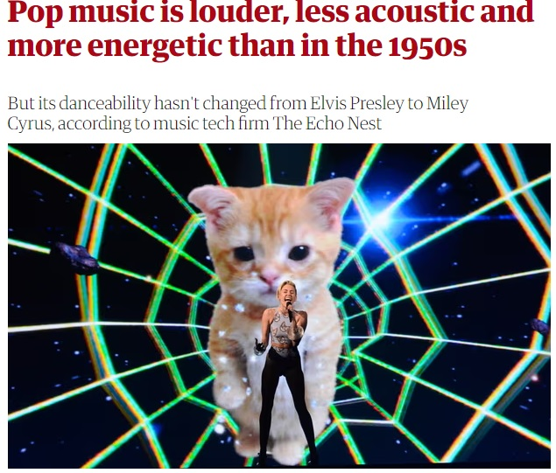
Data frame and clusters analysis
EXPLORE and plot RELATION BETWEEN SUM OF ENERGY AND ACUSTICNESS
Modern music is just noise. You can't hear the words properly. Those electronic things aren't proper instruments. Why is it all so loud? You can't dance to this, not like in my day.
Data alchemist" Glenn McDonald, running tests on the 5,000 hotttest [sic] tracks from 1950 to 2013 to see how specific attributes – including energy, loudness, organicness, acousticness and mechanism – have changed over that time.
TIME IS IMPORTANT FACTOR in MUSIC!

Slide 15
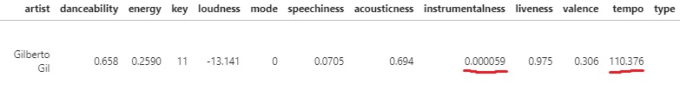
Are Spotify’s audio features able to identify “similar songs”, as defined by humanly detectable criteria?
Spotify Criteria are
Relevant
well structured and defined
BUT, tempo and instrumentalness are maybe over & under estimated that could impact on results of melodies clusterization (greater number of outliers)
Average person most likely will not be capable to distinct and search melodies based on the spotify classification criteria as those criteria are complex for understanding
Therefore our recommendation is as follow on next slides…

Slide 16
Additional data for better user experience
As premises for our algorithm methodology and analysis is based on melodies energy and accusticness which are generaly connected to music creation period (year), we believe that including year of the melodies production can bring better user experience
Additional melodies and artist should be included in the playing list clusters with lower number of artist and melodies i.e.
# soul = 6
# pop = 7

Slide 17
Recommendations & Learnings from the project
Recommendations
Classification of the users experience based on "Song_year_created" which proved to be connected with “energy and accusticness” is solid basis for creating Unsupervised Moosic Maschine Learing Model that will automate classification of music based on proposed “genre” structure.
Learnings from the project
Based on data frame first decision should be which ML model to chose
It is important to recognise how set of data correlate in order to choose correct data pairs for exploration
ML algorithms prefer certain models and scaling methodologies than oders, explore this before
I finally resolve issue from “sniping tool” and better learned Anaconda JupiterLab

